Slide 1

AI-driven Oral Tumor
Evolution Predictor
By Team HexaHer
Team Member :
Shruti Sharma
Sanjana Kumari
Akansha Pandit

Slide 2
The Problem: Unpredictable Oral Cancer Tumor Evolution
Oral cancer progression is highly unpredictable, forcing clinicians to make high-stakes decisions from limited, static snapshots (imaging, labs). This leads to delayed interventions, treatment failures, and poor patient outcomes. There's an urgent need for personalized, predictive insights.
Solution: AI-driven Oral Tumor Evolution Predictor
The AI-driven Oral Tumor Evolution Predictor is an AI-based solution intended to make individualized predictions of oral tumor evolution and therapeutic response
Core Approach:
Digital Twin Technology: Creates a dynamic, AI-based model of each patient's tumor.
"What-If" Scenario Simulations: Predicts responses to various treatment plans.
Explainable & Personalized Insights: Provides clear, data-driven recommendations.
Key Benefits:
Improved Patient Outcomes: Enables tailored, effective treatments.
Enhanced Clinical Decisions: Supports oncologists with predictive insights.
Reduced Healthcare Costs: Minimizes ineffective therapies and complications.
3

Slide 3
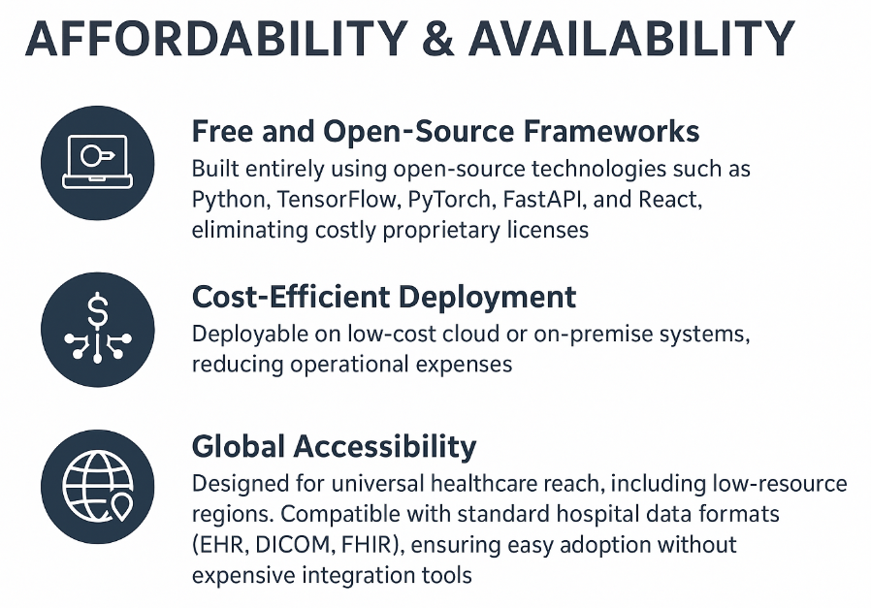
Uniqueness / Innovation :
Real-time Tumor Digital Twin: Dynamic, personalized AI model for individual tumor evolution.
Interpretable "What-If" Scenarios: Safe, virtual testing of therapies with clear, AI-driven explanations.
Multimodal Data Fusion: Comprehensive integration of diverse patient data for holistic insights.
Oral Oncology Focus: Specialized precision tool for a top-10 global cancer.
Tech Stack:
AI/Backend: Python (TensorFlow), FastAPI,
Frontend: React (Visualization Dashboard)
Database: CSV File for input
Explainability: Generative AI, CNN Model for image processing
Visualization tools: Matplotlib, Noise, Pillow, NumPy, Plotly

Slide 4
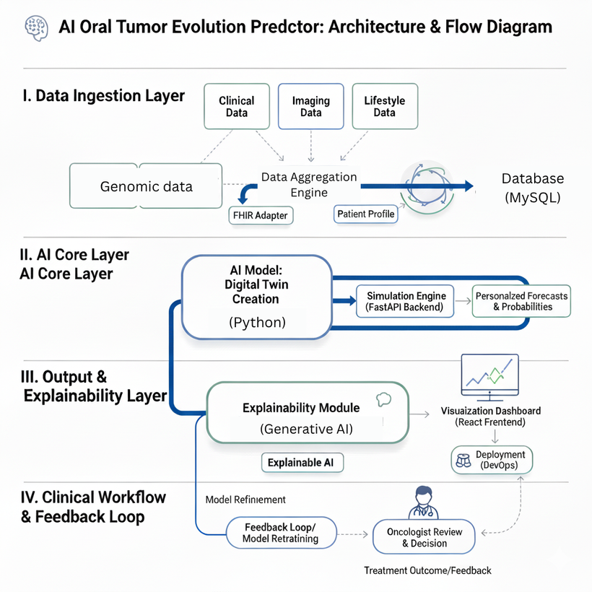
Architecture & Flow Diagram

Slide 5
Feasibility: Designed for Integration and Scale
Impact: Driving Clinical and Global Change
Seamless Data Integration
Accelerated Clinical Decisions
Integrates smoothly with standard hospital data formats, including Electronic Health Records (EHR), genomic sequencing, and advanced imaging data, ensuring minimal disruption to existing workflows.
Enables significantly faster diagnosis and treatment planning, leading to reduced treatment failures and improved patient pathways.
Scalability Across Resource Settings
AI-Powered Precision Oncology
The architecture is scalable, designed to function effectively in both high-resource centers with advanced IT infrastructure and in low-resource healthcare setups through optimized deployment strategies.
Delivers highly accurate, evidence-based treatment recommendations tailored to individual patient profiles, revolutionizing personalized care.
Regulatory-Ready Explainability
Lower Healthcare Costs
Built-in transparent AI reasoning (XAI) and mechanisms for clinical validation support to meet stringent regulatory requirements and build clinical trust.
Achieves financial efficiency by recommending optimal therapies upfront, minimizing the use of ineffective treatments, and reducing the length of hospital stays.
Resource Requirements
Global Societal Alignment
Deployment requires moderate cloud credits for processing and storage, alongside essential clinical mentorship for localized model validation and successful deployment.
Directly contributes to UN Sustainable Development Goal 3 (Good Health and Well-being) and Goal 9 (Industry, Innovation, and Infrastructure).

Slide 6
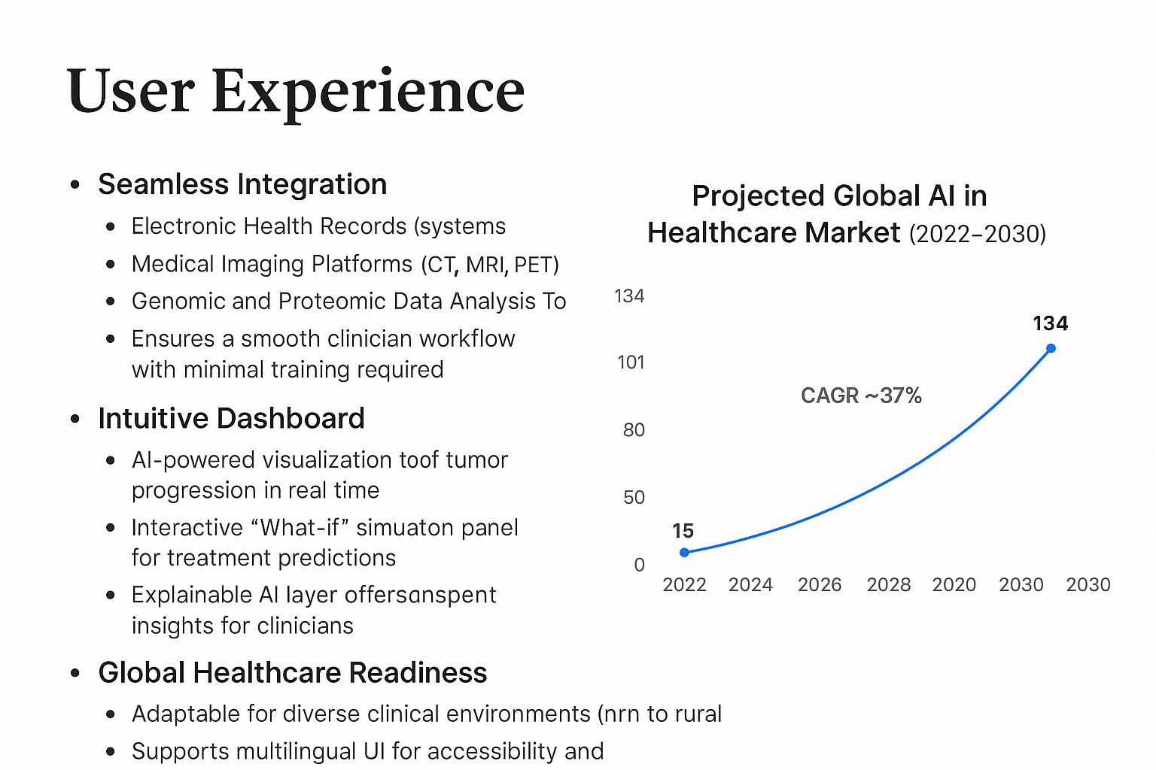

Slide 7





The Business Model Canvas
Key Partners
Key Activities
Value Propositions
Hospitals & Oncology Clinics: Providing clinical access and data feedback.
AI Model Development & Validation: Continuous refinement of predictive algorithms.
Personalized tumor predictions for clinician trust.
Virtual “What-if” treatment simulations.
Medical Universities & Research Labs: For ongoing validation and cutting-edge data access.
Digital Twin Simulation & Dashboard Development: Creating intuitive, real-time user interfaces.
Reduces Ineffective Treatments: Minimizing side effects and accelerating time to effective therapy.
Regulatory & Ethics Boards: Ensuring compliance and responsible AI deployment.
Compliance & Regulatory Testing: Maintaining standards for safety and efficacy.
Scalable for All Settings: Accessible to both advanced and resource-limited hospitals.
Customer Segments
Oncologists & Clinical Decision Support Teams: Direct users benefiting from predictive insights.
Hospitals & Cancer Research Centers: Institutional adopters seeking operational and clinical excellence.
Public Health Organizations: Leveraging insights for population-level cancer strategy.
75%
15%
10%
Subscription SaaS
Licensing/API Access
Research Collaborations
Primary revenue from hospital annual or per-patient subscriptions for platform access.
Revenue from third-party health-tech companies integrating our predictive engine into their systems.
Funding from pharmaceutical and academic partners for specialized clinical validation studies.

